Slide 1


IBM Cognos Analytics Dashboard-Coffee Reviews

Slide 2
IT_AIML_A2
18481a1244 – Katepalli Priyanka
18481a1219 – Bogem Srinivas Rao
18481a1225 – Done Manasa
19485a1204 – Koppineni Eswari Priyanka

Slide 3
Project Idea:
In this project, we will be building a Product review Analytics Dashboard using IBM Cognos Analytics and Watson discovery. This Dashboard should have the following capabilities:
Get early warning of developments primarily based on client feedback.
Address escalating customer interactions with early intervention.
Target the proper clients with the right product and the proper marketing..
Know the place to make investments in your business to power income and customer adoption.
Get to the root purpose of churning customers.
The theme of this code pattern is built around data for a small coffee manufacturer that sells their products in local markets.
The statistics will consist of evaluations and scores for their specific coffee flavors.
Product Review records are loaded into Watson Discovery for enrichment. Results consist of sentiment evaluation and key-word discovery.
User runs Cognos Analytics.
Data files are loaded directly into Cognos Analytics.

Slide 4
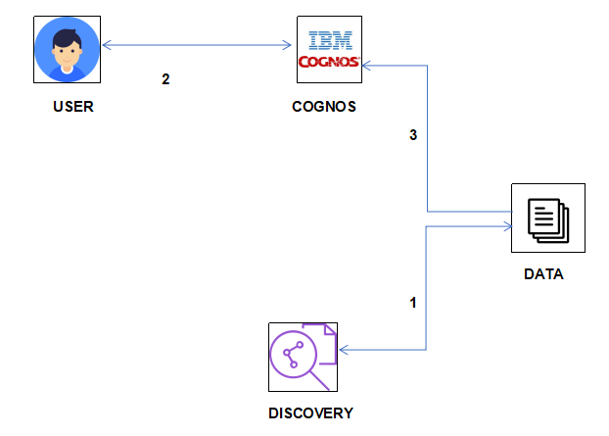
Architecture:

Slide 5
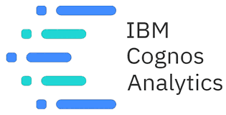
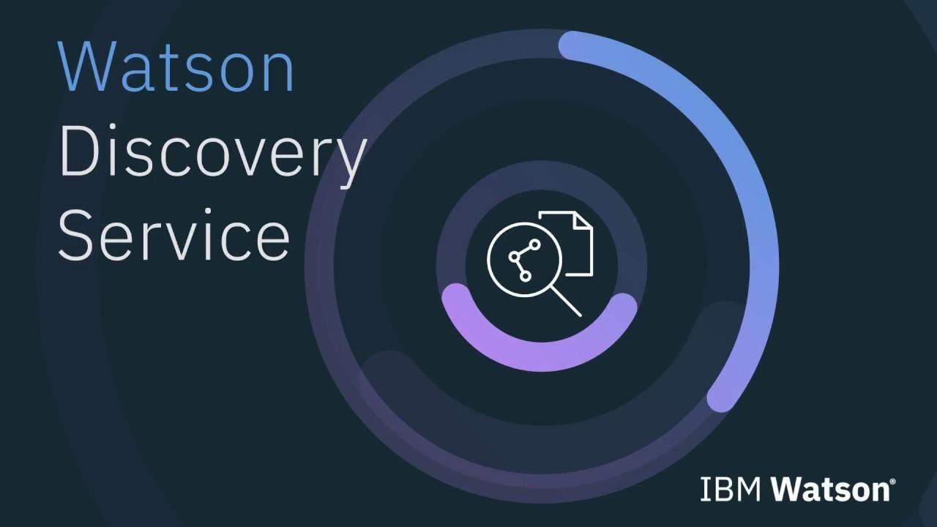
Solution Requirements
Services Used: IBM Cognos Analytics and Watson Discovery

Slide 6
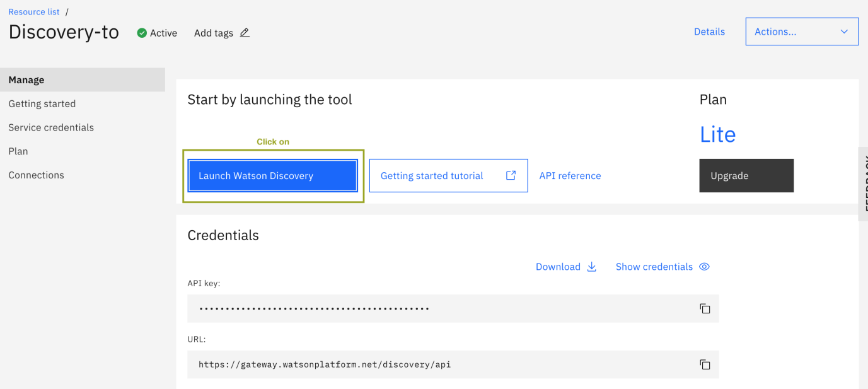
Creation Of IBM Account
Create IBM Watson Discovery Service

Slide 7
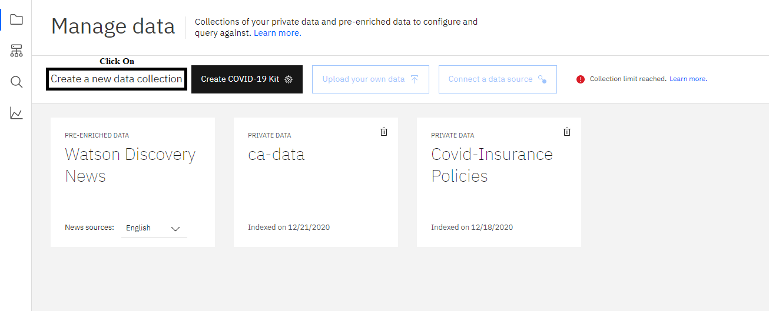
Creating Collection

Slide 8
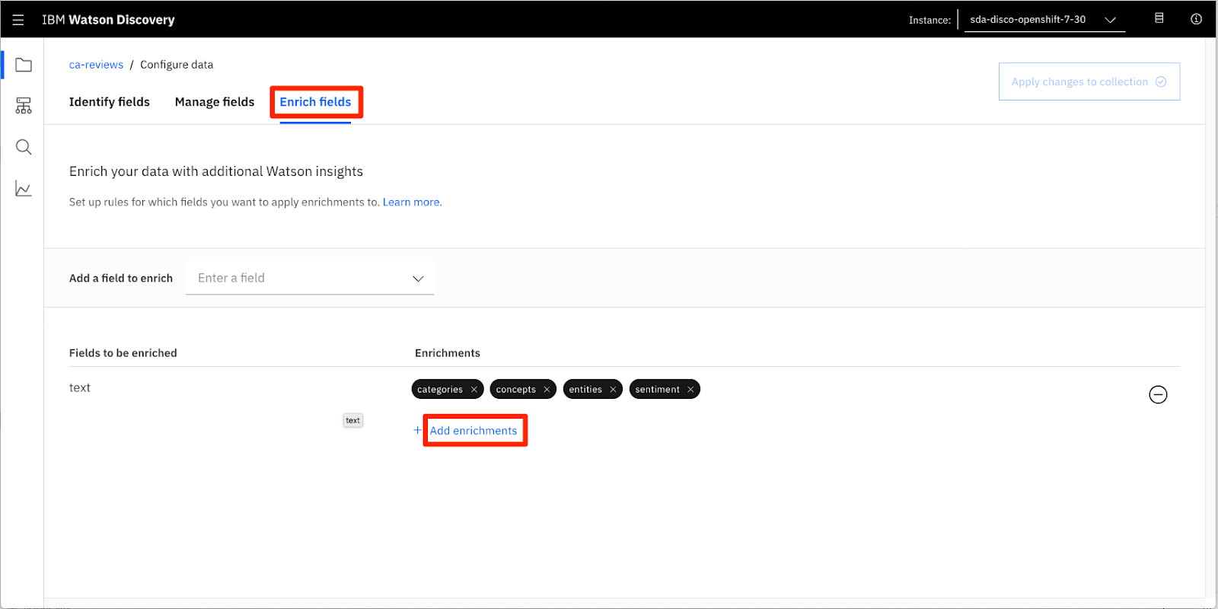
Configure The Collection

Slide 9
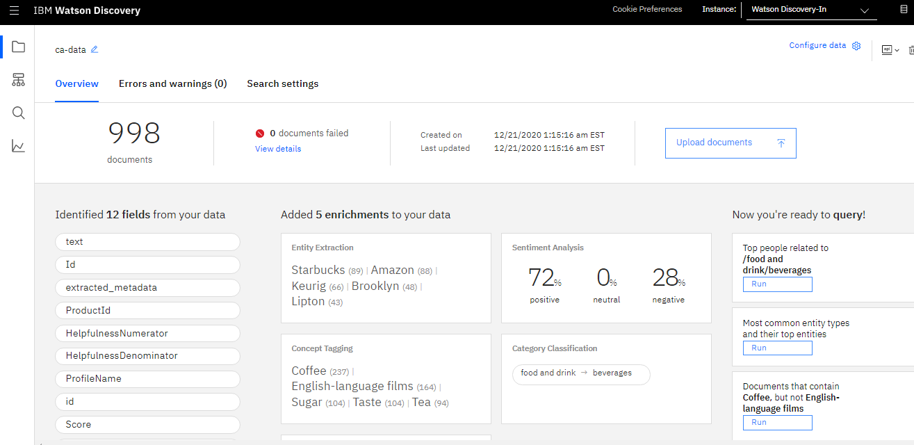
Load The Product Review Files

Slide 10
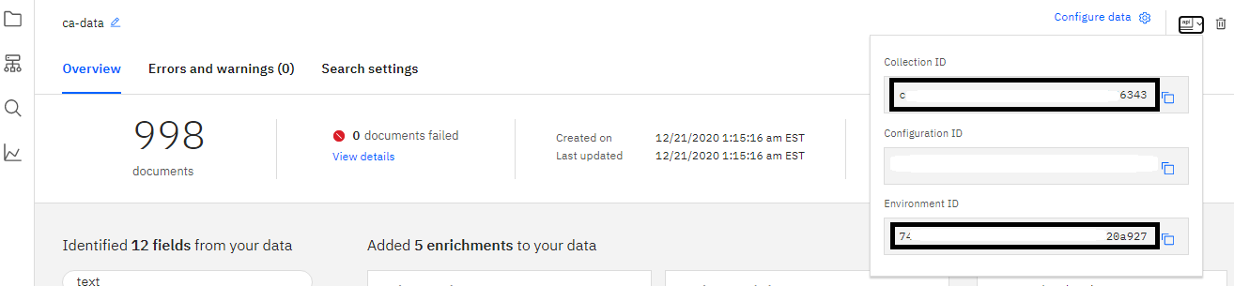
Add Service Credentials To Environment File

Slide 11
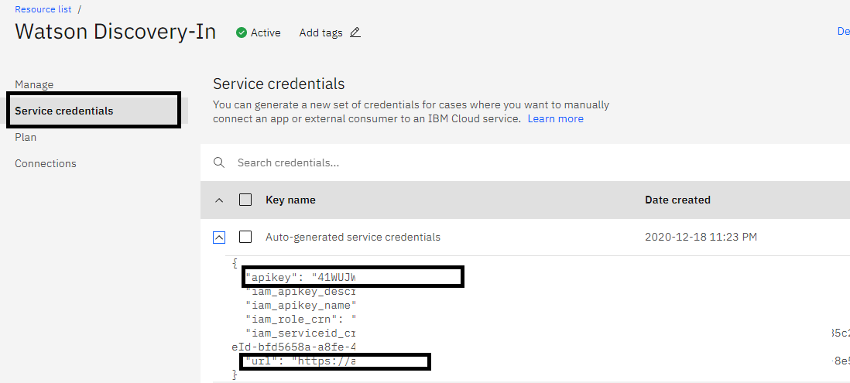

Slide 12
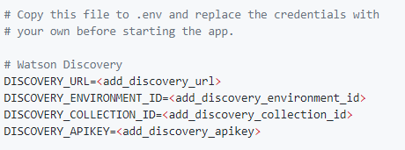
env.sample:

Slide 13
Run Scripts To Generate Data
Reviews - this contains all of the reviews for each of the products. Includes rating and sentiment score.
Products - this is information about each of our products. Includes product_id, name, and unit price.
Keywords - this contains keywords generated from product reviews.

Slide 14
Build A Data Module In Cognos Analytics
Upload Files Into Cognos Analytics
data/out-products.csv
data/out-reviews.csv
data/out-keywords.csv

Slide 15
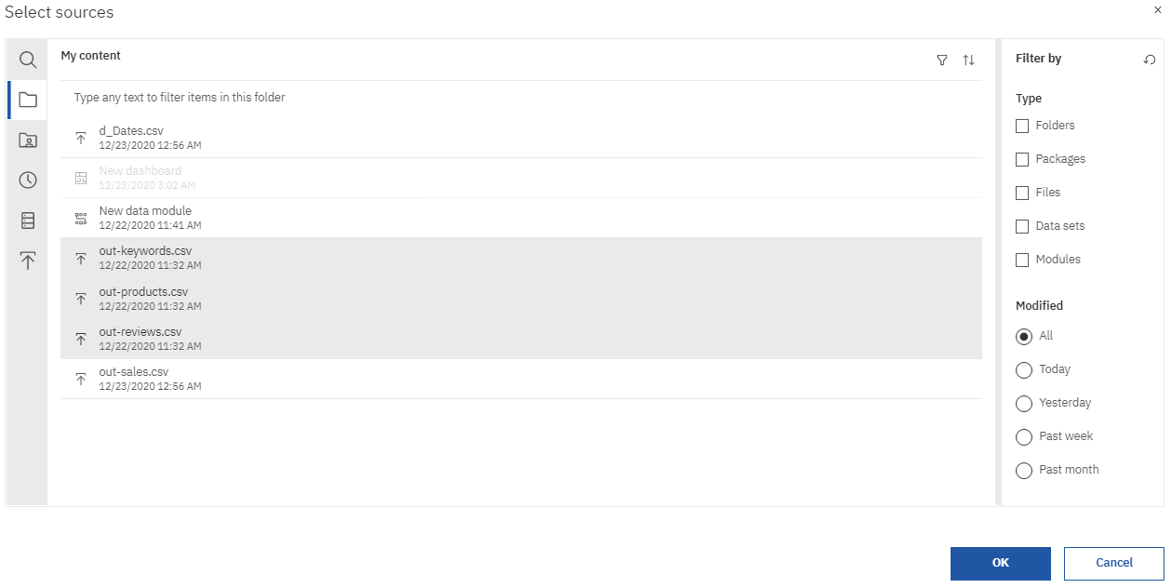
Create A New Data Module

Slide 16
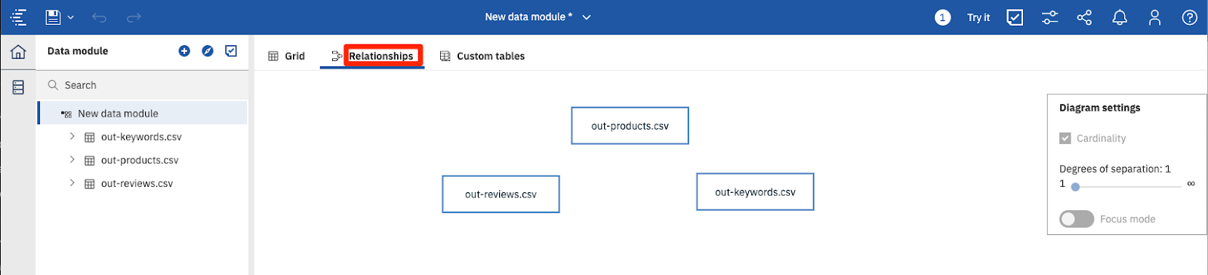

Slide 17
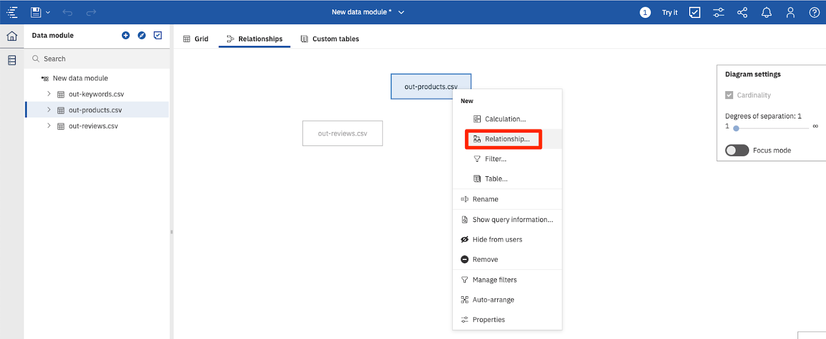

Slide 18
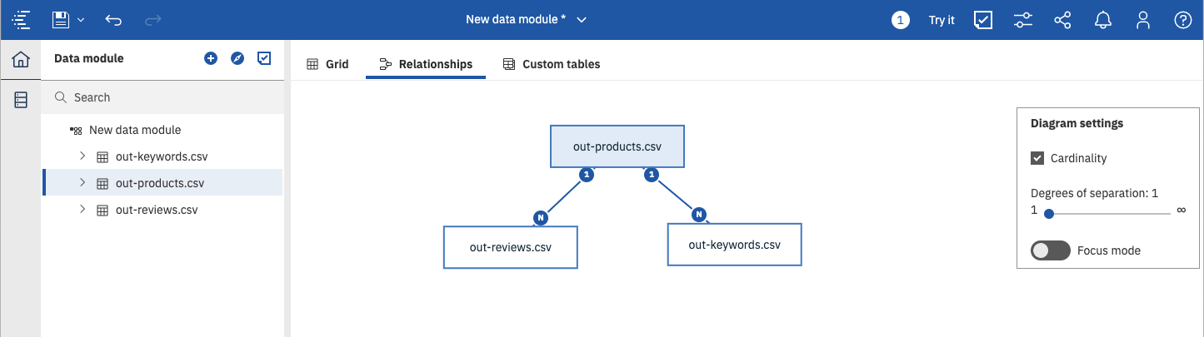

Slide 19
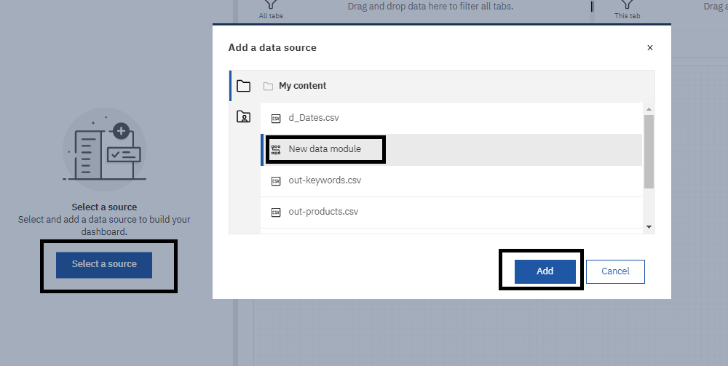
Create A Cognos Analytics Dashboard
Create A Dashboard

Slide 20
Add Visualizations To The Dashboard

Slide 21
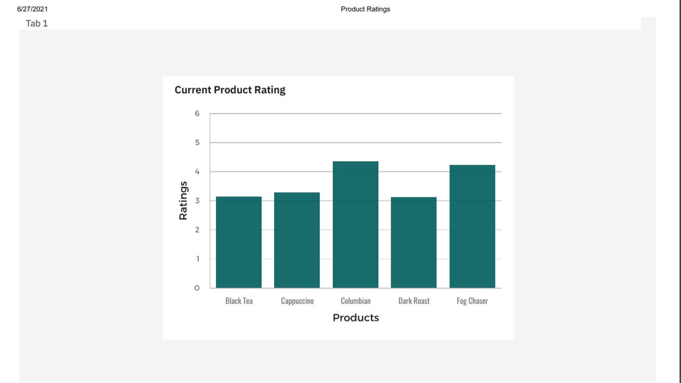

Slide 22
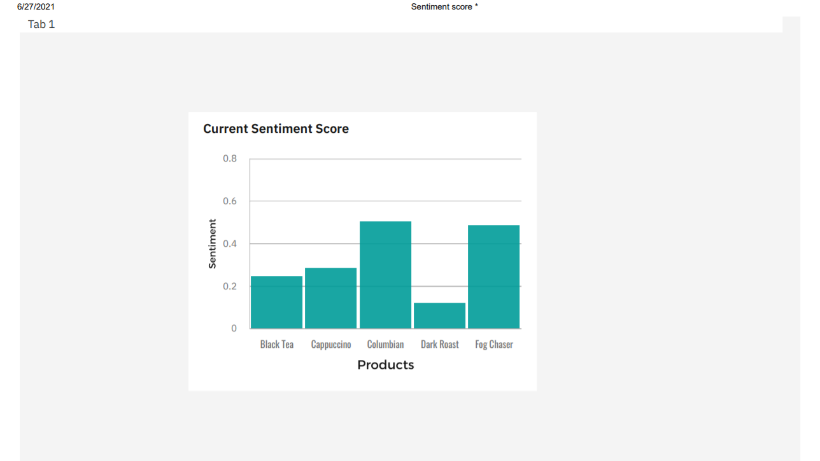

Slide 23
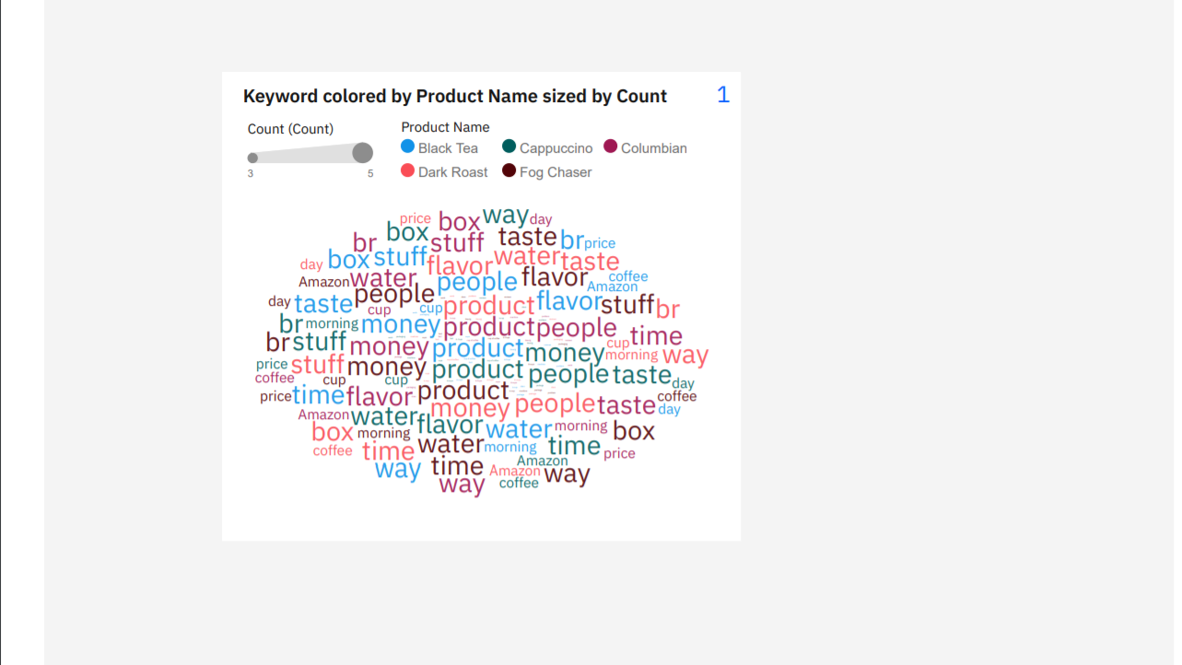

Slide 24
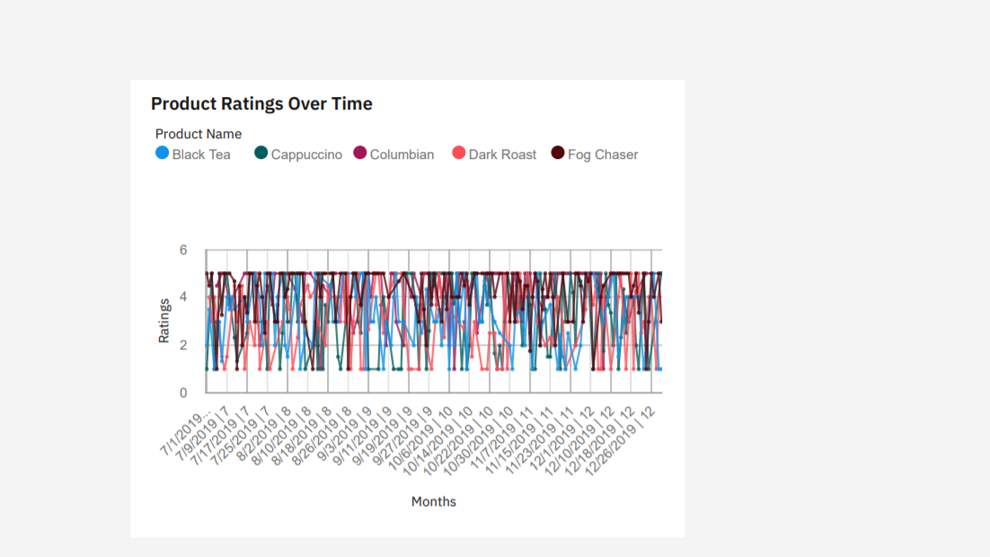

Slide 25
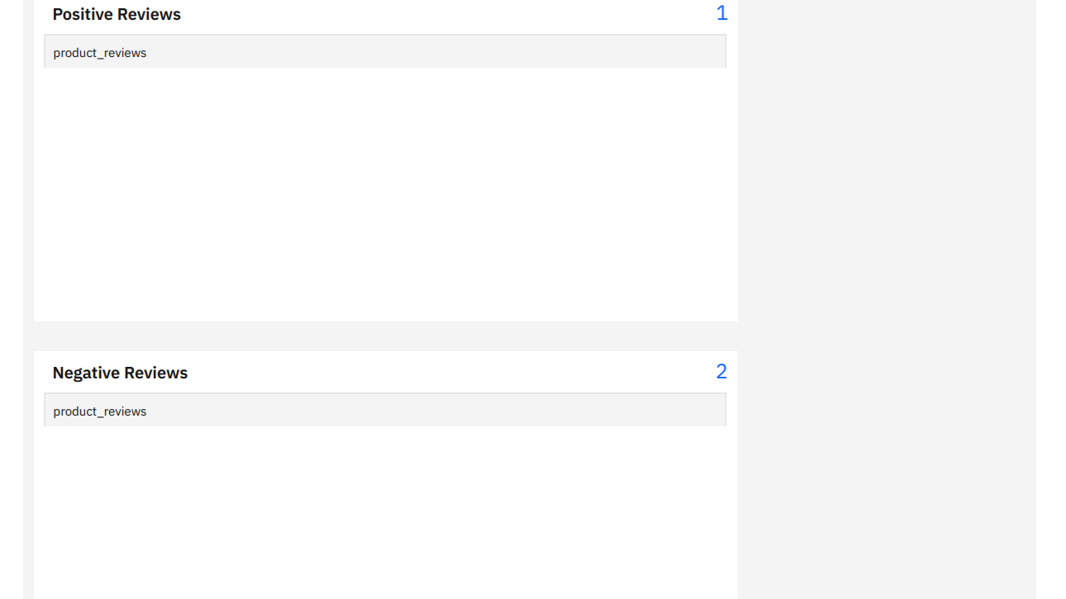

Slide 26
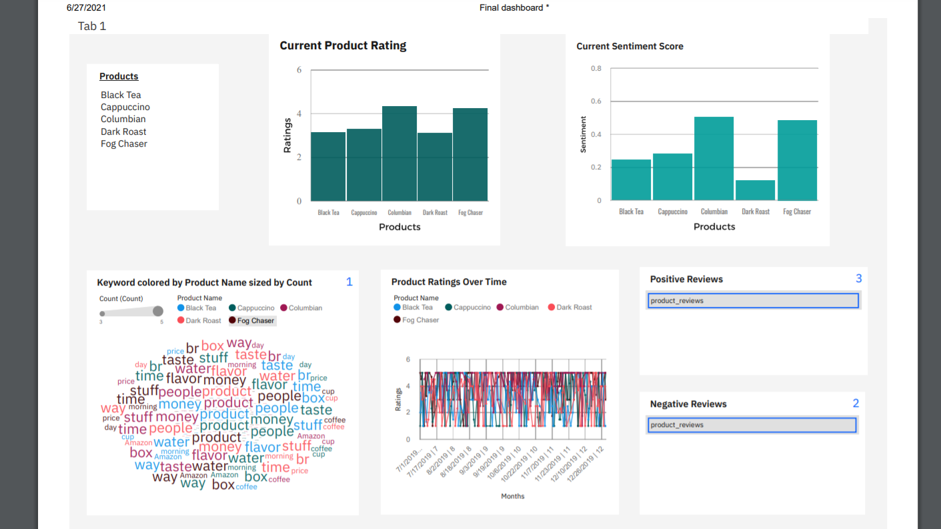

Slide 27
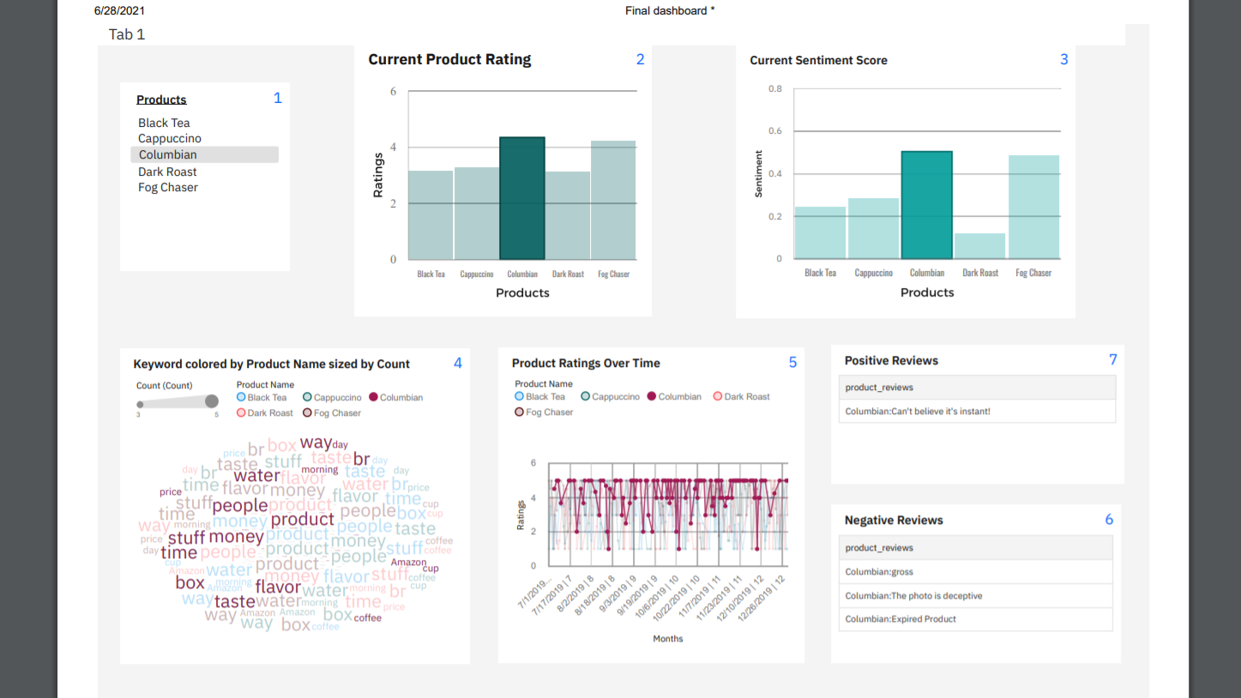

Slide 28


